Slide 1
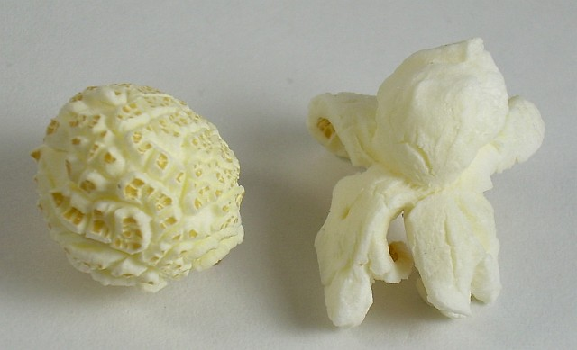
Academy Popcorn "API"
Description, Classes, Interfaces, Hierarchy, Specifics
George Georgiev
Technical Trainer
itgeorge.net
Telerik Software Academy
academy.telerik.com

Slide 2
Contents
Overview
The GameObject class
Important members
The IRenderable and ICollidable interfaces
The Block class
The IRenderer interface and ConsoleRenderer
The MovingObject and Ball classes
The IUserInterface and KeyboardInterface
The Engine class

Slide 3
Academy Popcorn API
Overview
Notes:
(c) 2006 National Academy for Software Development - http://academy.devbg.org*
3##

Slide 4
Academy Popcorn API
Provides an API for a matrix-based game of Popcorn/Blockbuster
Important classes
GameObject – base class for objects in the game (like System.Object in C#)
IRenderer – interface for rendering objects
IUserInterface – interface for handling input
Engine – runs the game, checks for input and renders the scene
CollisionDispatcher – notifies objects of their collisions
4

Slide 5
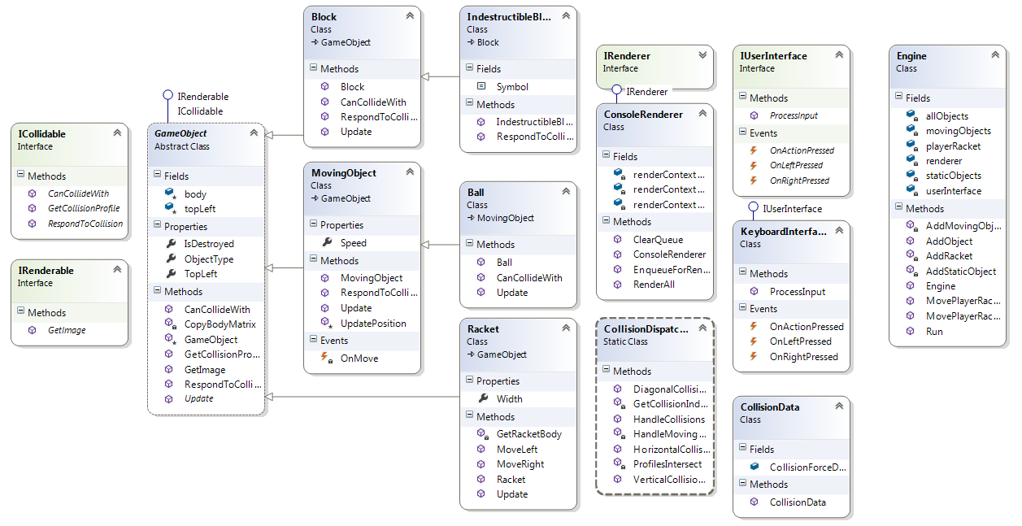
Academy Popcorn API
Class Diagram
Notes:
(c) 2006 National Academy for Software Development - http://academy.devbg.org*
5##

Slide 6
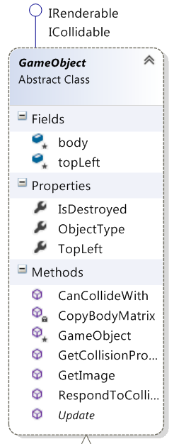
The GameObject class
Notes:
(c) 2006 National Academy for Software Development - http://academy.devbg.org*
6##

Slide 7
The GameObject class
Base class for all objects in the game world
Abstract class
There is no such thing as "just an object"
it's either a block, a racket or something else
Has a protected constructor
Implements the IRenderable interface
Provides a GetImage method – returns a char matrix for visualization
Used by the IRenderer – will be covered later
7

Slide 8
The GameObject class (2)
Implements the IObjectProducer interface
Enables objects to produce other objects
Implements the ICollidable interface
Enables objects to participate and respond to collisions
The Update method
Abstract method
Inheriting classes implement their behavior there
8

Slide 9
The GameObject class (3)
Other fields
TopLeft – top left coordinates of the object in the world
Represented by instance of MatrixCoords
body – defines the body of the object as a char matrix
IsDestroyed – property indicating if the object should be removed from the world
9

Slide 10
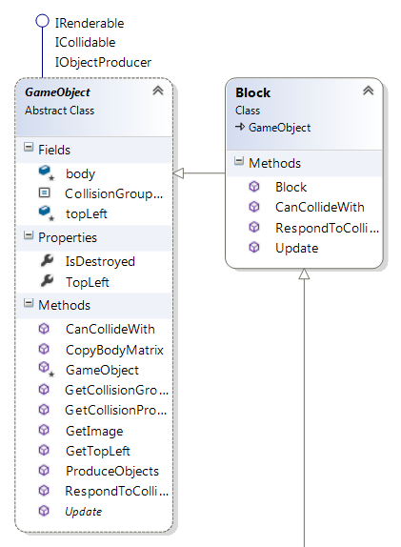
The Block class
Notes:
(c) 2006 National Academy for Software Development - http://academy.devbg.org*
10##

Slide 11
The Block class
Inherits the GameObject class
Describes a destructible block
Has implemented ICollidable methods
Note: all classes inheriting GameObject MUST implement the ICollidable methods if they need specific collision detection
Has a constructor, which initializes the body
1x1 char matrix with a symbol
11

Slide 12
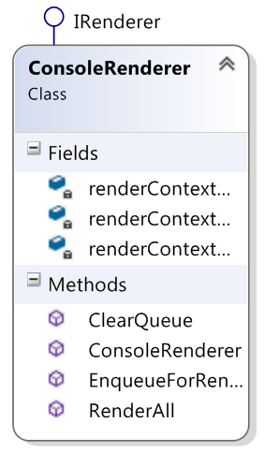
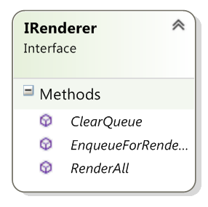
The IRenderer Interface and ConsoleRenderer
Notes:
(c) 2006 National Academy for Software Development - http://academy.devbg.org*
12##

Slide 13
IRenderer & ConsoleRenderer
IRenderer – provides interface to methods for displaying IRenderable
EnqueueForRendering – adds a IRenderable to the rendering queue
RenderAll – flushes the rendering queue to the screen
ClearQueue – removes all objects from the rendering queue
Should be called after RenderAll
ConsoleRenderer – implements IRenderer for console display
13

Slide 14
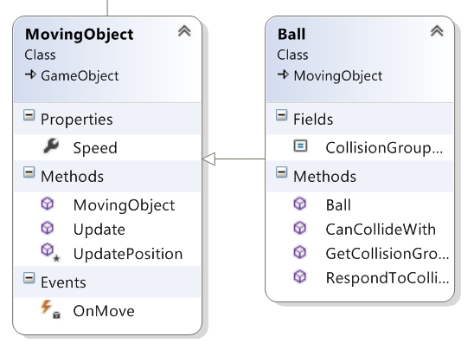
The MovingObject and Ball Classes
Notes:
(c) 2006 National Academy for Software Development - http://academy.devbg.org*
14##

Slide 15
MovingObject & Ball
MovingObject – game object with a speed property
Speed is a vector
Represented by instance of MatrixCoords
Imagine "delta" coords – the change of TopLeft at each "turn"
Has overridden Update
Updates the TopLeft by adding Speed
Ball – inherits MovingObject with bouncing behavior
Overrides RespondToCollision
15

Slide 16
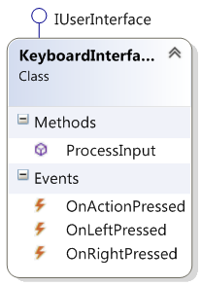
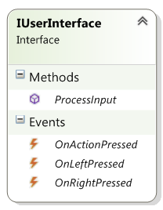
The IUserInterface and KeyboardInterface
Notes:
(c) 2006 National Academy for Software Development - http://academy.devbg.org*
16##

Slide 17
IUserInterface & KeyboardInterface
IUserInterface – provides processing of user input
ProcessInput method – checks for user input and signals the appropriate events
OnActionPressed, OnRightPressed, OnLeftPressed
Events for action (e.g. "shoot" ), move left and move right (e.g. joystick left or keyboard left arrow)
KeyboardInterface – implements IUserInterface for keyboard interaction
17

Slide 18
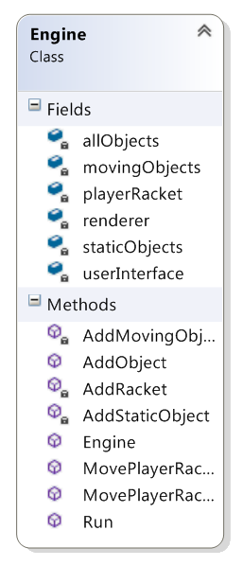
The Engine Class
Notes:
(c) 2006 National Academy for Software Development - http://academy.devbg.org*
18##

Slide 19
The Engine Class
Manages game objects, user interface and visualization; all public methods are virtual
Uses a IUserInterface
Uses a IRenderer
Has several GameObject lists
allObjects
movingObjects
staticObjects
Has a separate Racket object
For control over the player racket
Has methods for controlling the Racket
19

Slide 20
The Engine Class (2)
Important members
AddObject method – adds a GameObject to the engine
Run method – starts a "game loop":
Draws the scene
Checks for input
Clears the rendering queue
Calls Update for all objects
Calls ProduceObjects for all objects and collects
Removes all destroyed objects
Adds all produced objects
20

Slide 21
Academy Popcorn API
Questions?
http://academy.telerik.com

Slide 22
Exercises
The AcademyPopcorn class contains an IndestructibleBlock class. Use it to create side and ceiling walls to the game. You can ONLY edit the AcademyPopcornMain.cs file.
The Engine class has a hardcoded sleep time (search for "System.Threading.Sleep(500)". Make the sleep time a field in the Engine and implement a constructor, which takes it as an additional parameter.
Search for a "TODO" in the Engine class, regarding the AddRacket method. Solve the problem mentioned there. There should always be only one Racket. Note: comment in TODO not completely correct
Inherit the Engine class. Create a method ShootPlayerRacket. Leave it empty for now.
22

Slide 23
Exercises (2)
Implement a TrailObject class. It should inherit the GameObject class and should have a constructor which takes an additional "lifetime" integer. The TrailObject should disappear after a "lifetime" amount of turns. You must NOT edit any existing .cs file. Then test the TrailObject by adding an instance of it in the engine through the AcademyPopcornMain.cs file.
Implement a MeteoriteBall. It should inherit the Ball class and should leave a trail of TrailObject objects. Each trail objects should last for 3 "turns". Other than that, the Meteorite ball should behave the same way as the normal ball. You must NOT edit any existing .cs file.
Test the MeteoriteBall by replacing the normal ball in the AcademyPopcornMain.cs file.
23

Slide 24
Exercises (3)
Implement an UnstoppableBall and an UnpassableBlock. The UnstopableBall only bounces off UnpassableBlocks and will destroy any other block it passes through. The UnpassableBlock should be indestructible. Hint: Take a look at the RespondToCollision method, the GetCollisionGroupString method and the CollisionData class.
Test the UnpassableBlock and the UnstoppableBall by adding them to the engine in AcademyPopcornMain.cs file
Implement an ExplodingBlock. It should destroy all blocks around it when it is destroyed. You must NOT edit any existing .cs file. Hint: what does an explosion "produce"?
24

Slide 25
Exercises (4)
Implement a Gift class. It should be a moving object, which always falls down. The gift shouldn't collide with any ball, but should collide (and be destroyed) with the racket. You must NOT edit any existing .cs file.
Implement a GiftBlock class. It should be a block, which "drops" a Gift object when it is destroyed. You must NOT edit any existing .cs file. Test the Gift and GiftBlock classes by adding them through the AcademyPopcornMain.cs file.
25

Slide 26
Exercises (5)
Implement a shoot ability for the player racket. The ability should only be activated when a Gift object falls on the racket. The shot objects should be a new class (e.g. Bullet) and should destroy normal Block objects (and be destroyed on collision with any block). Use the engine and ShootPlayerRacket method you implemented in task 4, but don't add items in any of the engine lists through the ShootPlayerRacket method. Also don't edit the Racket.cs file. Hint: you should have a ShootingRacket class and override its ProduceObjects method.
26

Slide 27
Exercises (6)
* Bonus task (optional): Download JustBelot game source from https://github.com/NikolayIT/JustBelot (code commits are made often so be sure to always work on the latest game source). Write your own C# library called JustBelot.AI.YourBotName and write a class in it that implements JustBelot.Common.IPlayer interface. Implement your own AI belot player that will fight with other AI players. The winner will be awarded. Please send your players to academy@telerik.com and add them in the homework archive when you upload it. You are allowed to work in teams. This task is not obligatory. Discussions: here.

